Slide 1
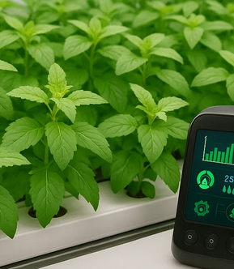
Revolutionizing Holy-Basil Cultivation With AI-Enabled Hydroponics System
Presented by : Mahmoud Kamal Abu Aisha
Supervised by: Dr. Ezzalden Edwan

Slide 2
Contents
Introduction
Related Work
Methodology
System Architecture
Future Scope
Conclusion
Proposed System
Results
References

Slide 3
Introduction
This study presents an IoT-based hydroponic system designed to grow exotic and medicinal plants, particularly Rama Tulsi (Holy Basil). It integrates Azure IoT Hub, Containers, and DataBricks to analyze sensor data using logistic regression and detect NPK deficiencies, calculating a “HealthinessScore” for each plant. The system uses ESP32S microcontrollers with built-in Wi-Fi, Bluetooth, and camera modules, along with a React-based portal for remote monitoring. The nutrient-enriched water is recycled, enabling faster nutrient absorption. The system enhances plant growth efficiency, reduces manual intervention, and minimizes space and time needed for cultivation.

Slide 4
Related Work
[1] M. S. Farooq, S. Riaz, M. A. Helou, F. S. Khan, A. Abid, and
A. Alvi, ‘‘Internet of Things in greenhouse agriculture: A survey on
enabling technologies, applications, and protocols,’’ IEEE Access, vol. 10,
pp. 53374–53397, 2022.
[2] M. Mehra, S. Saxena, S. Sankaranarayanan, R. J. Tom, and
M. Veeramanikandan, ‘‘IoT based hydroponics system using deep
neural networks,’’ Comput. Electron. Agricult., vol. 155, pp. 473–486,
Dec. 2018. [3] H. S. Grewal, B. Maheshwari, and S. E. Parks, ‘‘Water and nutrient use
efficiency of a low-cost hydroponic greenhouse for a cucumber crop:
An Australian case study,’’ Agricult. Water Manage., vol. 98, no. 5,
pp. 841–846, Mar. 2011. [4] S. V. S. R. Raju, B. Dappuri, P. R. K. Varma, M. Yachamaneni,
D. M. G. Verghese, and M. K. Mishra, ‘‘Design and implementation of
smart hydroponics farming using IoT-based AI controller with mobile
application system,’’ J. Nanomater., vol. 2022, pp. 1–12, Jul. 2022. [5] I. Ezzahoui, R. A. Abdelouahid, K. Taji, and A. Marzak, ‘‘Hydroponic and
aquaponic farming: Comparative study based on Internet of Things IoT
technologies,’’ Proc. Comput. Sci., vol. 191, pp. 499–504, Feb. 2021. [6] M. Gentry, ‘‘Local heat, local food: Integrating vertical hydroponic farming
with district heating in Sweden,’’ Energy, vol. 174, pp. 191–197,
May 2019.
[7] M. S. Abu- Shahba, M. M. Mansour, H. I. Mohamed, and M. R. Sofy,
‘‘Comparative cultivation and biochemical analysis of iceberg lettuce
grown in sand soil and hydroponics with or without microbubbles and
macrobubbles,’’ J. Soil Sci. Plant Nutrition, vol. 21, no. 1, pp. 389–403,
Mar. 2021.
[8] M. Bassiouny, P. Nasr, and H. Sewilam, ‘‘Investigating the pilot-scale performance
of a hydroponic nutrient solution as potential draw solution for
fertilizer drawn forward osmosis and hydroponic agriculture of lettuce,’’
Clean Technol. Environ. Policy, vol. 24, no. 9, pp. 2749–2760, Jul. 2022.
[9] D. Saraswathi, P. Manibharathy, R. Gokulnath, E. Sureshkumar, and
K. Karthikeyan, ‘‘Automation of hydroponics green house farming using
IoT,’’ in Proc. IEEE Int. Conf. Syst., Comput., Autom. Netw. (ICSCA),
Jul. 2018, pp. 1–4 .
[10] G. Marques, D. Aleixo, and R. Pitarma, ‘‘Enhanced hydroponic agriculture
environmental monitoring: An Internet of Things approach,’’ in Proc.
Int. Conf. Comput., in Lecture Notes in Computer Science, Jun. 2019,
pp. 658–669.
[11] S. B. Dhal, S. Mahanta, J. Gumero, N. O’Sullivan, M. Soetan, J. Louis,
K. C. Gadepally, S. Mahanta, J. Lusher, and S. Kalafatis, ‘‘An IoT-based
data-driven real-time monitoring system for control of heavy metals to
ensure optimal lettuce growth in hydroponic set-ups,’’ Sensors, vol. 23,
no. 1, p. 451, Jan. 2023.
[12] T. Yang and H.-J. Kim, ‘‘Comparisons of nitrogen and phosphorus mass
balance for tomato-, basil-, and lettuce-based aquaponic and hydroponic
systems,’’ J. Cleaner Prod., vol. 274, Nov. 2020, Art. no. 122619.
[13] P. H. Triastinurmiatiningsih, A. Qur’ania, and R. F. Hermawan, ‘‘Effects of
deficiency nitrogen phosphorus potassium calcium in okra (Abelmoschus
esculentus L. Moench) through hydroponics,’’ Int. J. Recent Technol. Eng.,
vol. 8, no. 3, pp. 4393–4396, Sep. 2019 .
[14] C.-T. Chen, C.-L. Lee, and D.-M. Yeh, ‘‘Effects of nitrogen, phosphorus,
potassium, calcium, or magnesium deficiency on growth and photosynthesis
of Eustoma,’’ HortScience, vol. 53, no. 6, pp. 795–798, Jun. 2018 .

Slide 5
Problem Statement
🔸 Identified Gap
Traditional methods of cultivating medicinal plants like Ocimum Tenuiflorum (Holy Basil) are often inefficient, labor-intensive, and highly dependent on environmental conditions. These conventional farming practices face significant challenges, including:
Inconsistent nutrient delivery, leading to poor plant health and reduced yield.
Difficulty in real-time monitoring of key growth parameters such as pH, temperature, turbidity, and nutrient levels.
Inability to detect and respond early to deficiencies in critical macronutrients like Nitrogen (N), Phosphorus (P), and Potassium (K).
High dependency on manual labor for monitoring and intervention.
Limited access to scalable, automated, and cost-effective agricultural systems in urban or resource-constrained settings.
🔸 Contribution
critical need for an intelligent, automated, and real-time plant monitoring system that can optimize environmental conditions and nutrient delivery using advanced technologies such as the Internet of Things (IoT), cloud computing, and machine learning. Such a system must be capable of improving plant health, increasing crop yield, and reducing human intervention and resource consumption in hydroponic farming.

Slide 6
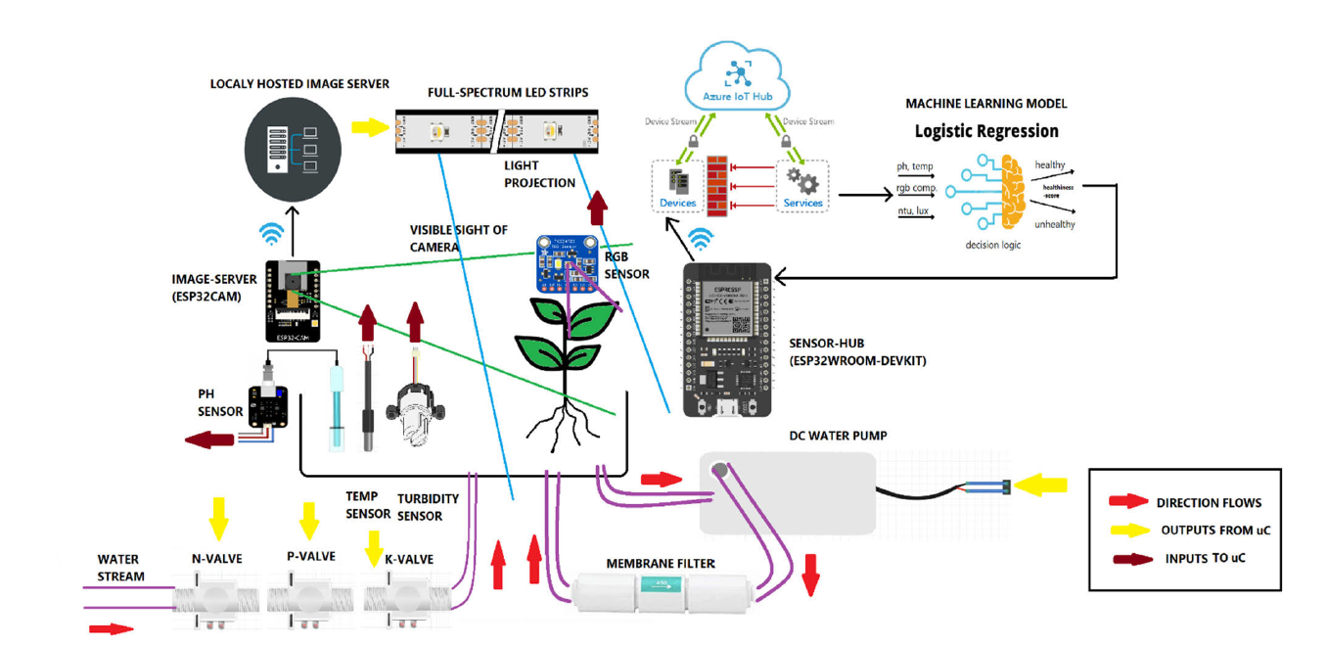
Proposed System
The proposed system is an AI-enabled hydroponic cultivation platform specifically designed to optimize the growth of Holy Basil (Ocimum Tenuiflorum) using IoT, cloud computing, and machine learning (ML) technologies.
Key Components:
IoT Hardware Setup:
Microcontrollers: ESP32-CAM and ESP32-WROOM.
Sensors: TCS34725 RGB color sensor , DS18B20 , Turbidity sensor , DFRobot pH sensor
Actuators: DC submersible water pumps, LED indicators, buzzers, and nutrient flow control valves.
Cloud Integration (Azure IoT & Databricks):
Real-time sensor data is transmitted to Azure IoT Hub, where it is stored as blobs.
Azure Databricks (PySpark) is used for big data analysis, healthiness scoring, and ML model training.
Machine Learning Models:
Logistic Regression and Decision Trees are used to:
Detect NPK deficiencies based on sensor data.
Compute a "Healthiness Score" based on a weighted formula using temperature, pH, turbidity, RGB deviation, and sunlight intensity.
Monitoring Portal:
A React-based web portal built with HTML/CSS/JavaScript provides:
Live plant images (from the ESP32-CAM).
Real-time sensor readings and control output.
Healthiness score updates and downloadable CSV logs.

Slide 7
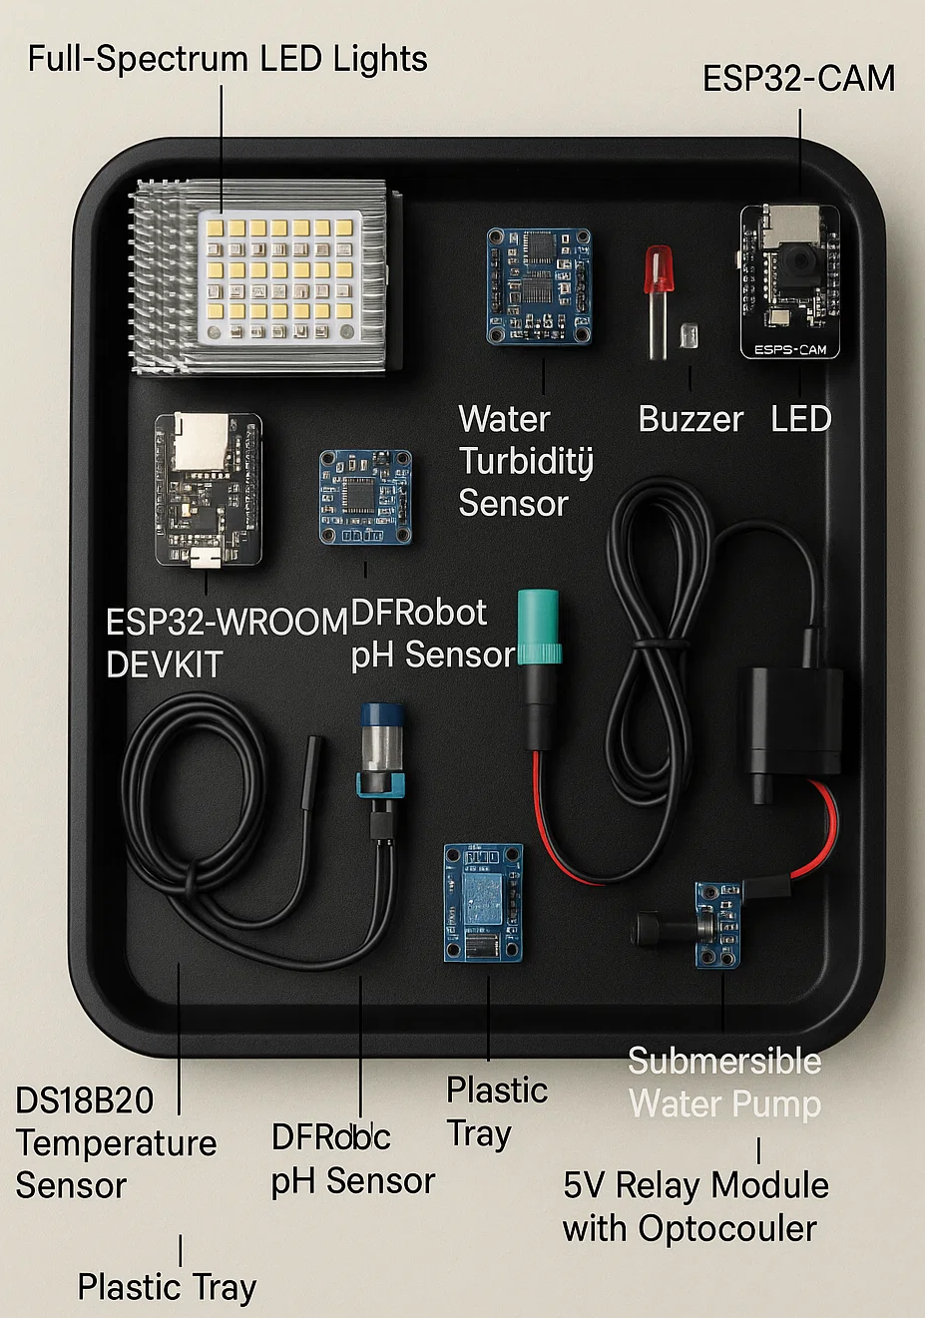
Methodology
A. TOOLS, FRAMEWORKS AND PARTS USED
1) HARDWARE PARTS ACQUIRED
The proposed hydroponic system uses a range of sensors and components to monitor and control plant growth in a water-based environment. Key hardware includes:
ESP32-CAM: A microcontroller with a built-in 2MP camera for real-time plant monitoring via Wi-Fi.
ESP32-WROOM DEVKIT: The central control unit connecting all sensors, featuring high processing power and wireless connectivity.
TCS34725 RGB Sensor: Measures water color to estimate nutrient levels.
DS18B20 Temperature Sensor: Monitors water temperature with high accuracy.
Water Turbidity Sensor: Detects suspended particles in water, indicating impurities like algae.
DFRobot pH Sensor: Measures water acidity/alkalinity.
Buzzers and LEDs: Provide status alerts for system issues (e.g., low water or nutrient imbalance).
Plastic Tray: Holds all system components in place.
Submersible Water Pump: Circulates nutrient-rich water and oxygen to plants.
Full-Spectrum LED Lights: Provide artificial sunlight for photosynthesis.
5V Relay Module with Optocoupler: Controls the pump and lights safely and efficiently.

Slide 8
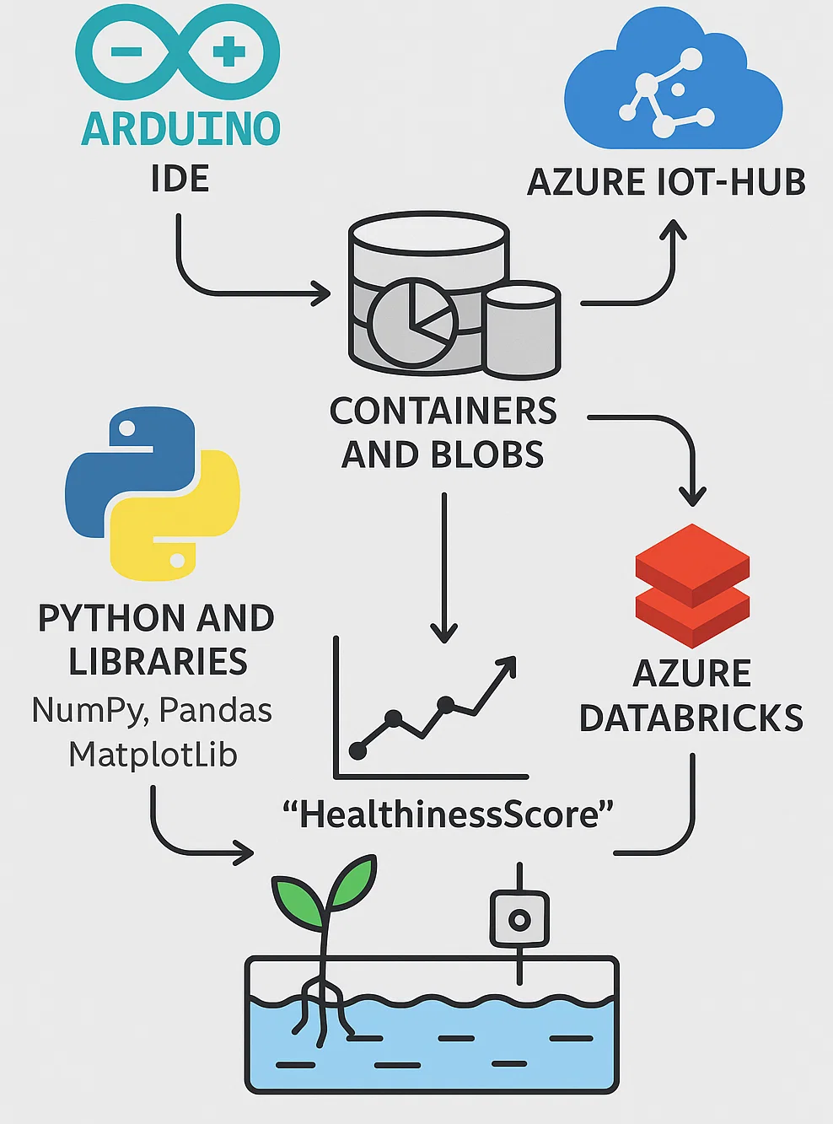
Methodology
2) SOFTWARES AND FRAMEWORKS CHOSEN
The system uses several software tools and frameworks to manage and analyze hydroponic data:
Arduino IDE: Used to program the microcontrollers controlling the hydroponic system. It offers libraries and support for IoT beginners.
Azure IoT-Hub: A cloud platform for remote monitoring, device management, and secure communication with IoT devices.
Containers and Blobs: Store real-time sensor data as JSON files in a time-sorted manner for later processing.
Azure DataBricks: Processes the stored data and runs logistic regression to calculate the plant’s “HealthinessScore.”
Python and Libraries: Python, with tools like NumPy, Pandas, and Matplotlib, is used for data analysis and supports intelligent decision-making in the system.

Slide 9
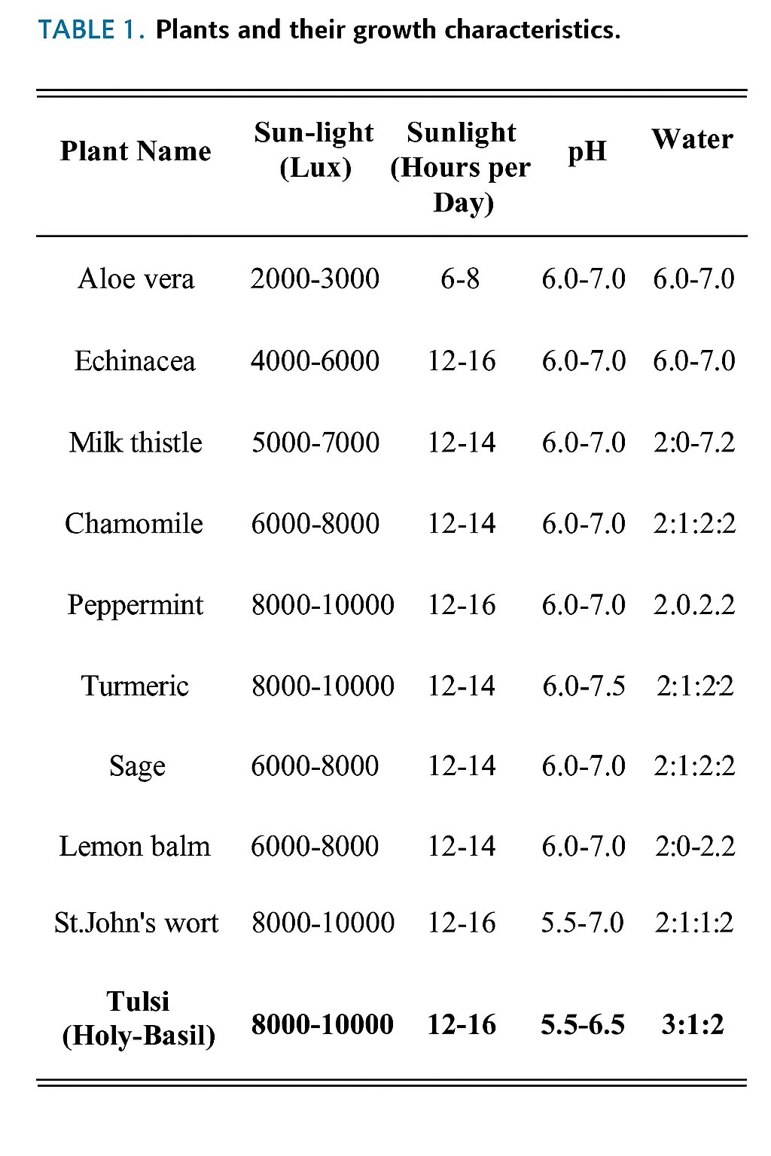
Methodology
3) HYDROPONIC NUTRIENTS
Hydroponic nutrients are specially formulated solutions that supply all essential minerals and trace elements required for healthy plant growth, including N, P, K, Ca, Mg, S, Fe, Mn, Zn, Cu, B, Mb, and Cl. These nutrients, dissolved in water, are quickly absorbed by plants and can be adjusted based on the plant type and growth stage.
The three most critical macronutrients are:
Nitrogen (N): Vital for chlorophyll production and photosynthesis.
Phosphorus (P): Supports root development, flowering, and fruiting.
Potassium (K): Helps in nutrient transport and overall plant health.
Maintaining proper NPK balance is crucial to ensure high yield and plant vitality in hydroponic systems.

Slide 10
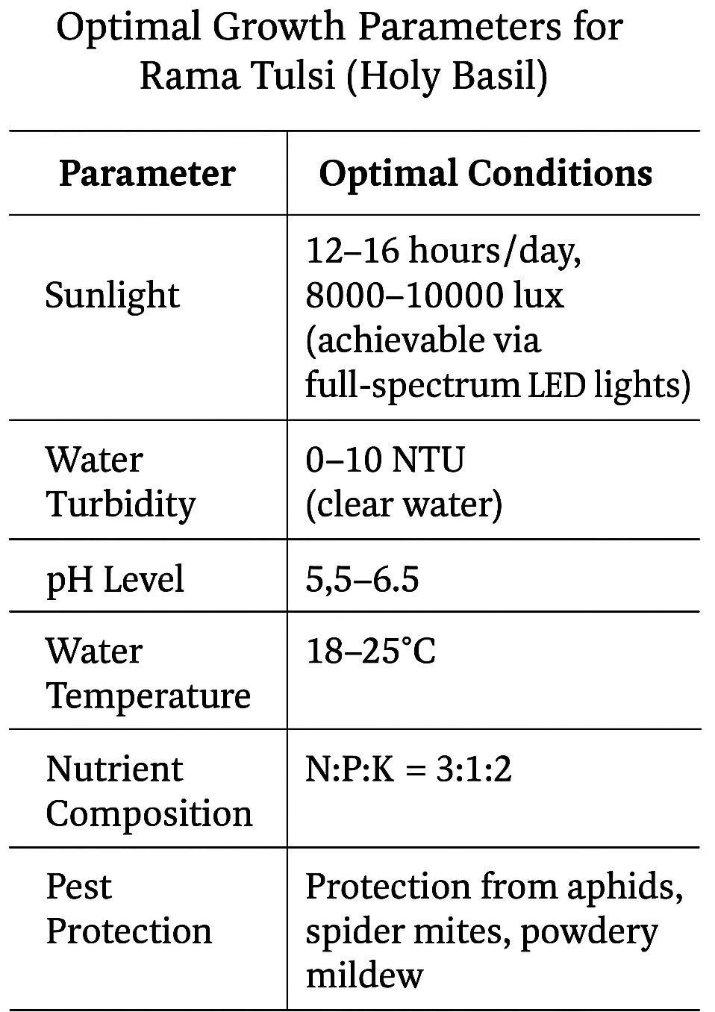
Methodology
4) IDEAL GROWTH PARAMETERS FOR HYDROPONIC PLANTS
To determine the ideal growth parameters for medicinal plants in Deep Water Culture (DWC) hydroponics, the researchers conducted extensive research and field visits to hydroponic nurseries. They gathered insights from experienced growers regarding optimal conditions like sunlight, pH, temperature, turbidity, and nutrient composition.
The compiled data (shown in Table 1) outlines specific needs for various plants. For Rama Tulsi (Holy Basil), the target plant in this study, the following optimal conditions were identified:
Sunlight: 12–16 hours/day, 8000–10000 lux (achievable via full-spectrum LED lights)
Water Turbidity: 0–10 NTU (clear water)
pH Level: 5.5–6.5
Water Temperature: 18–25°C
Nutrient Composition: N:P:K = 3:1:2
Rama Tulsi also requires protection from common pests like aphids, spider mites, and powdery mildew, making regular monitoring and a clean growing environment essential.

Slide 11
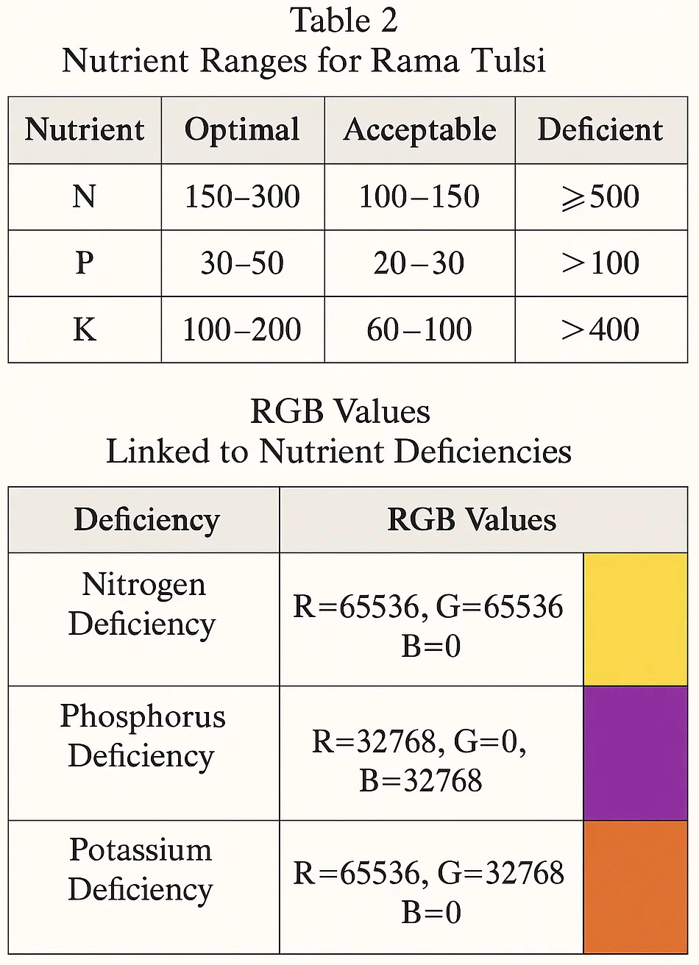
Methodology
5) NPK DEFICIENCIES
Nitrogen (N), Phosphorus (P), and Potassium (K) are the three essential macronutrients required in large amounts for healthy plant development. Deficiencies in any of these can lead to stunted growth, yellowing leaves, and reduced flowering or fruiting. Therefore, it is crucial to regularly monitor and adjust their levels in hydroponic systems.
Nitrogen (N): Supports leaf growth and photosynthesis.
Phosphorus (P): Aids root development and flower/fruit production.
Potassium (K): Regulates water balance and supports protein synthesis.
Table 2 outlines the optimal, acceptable, deficient, and toxic ranges (in ppm) for each nutrient for Rama Tulsi. For example, optimal nitrogen levels range from 150–300 ppm, and toxic levels exceed 500 ppm.
Table 3 presents the RGB values linked to deficiencies:
Nitrogen Deficiency: R=65536, G=65536, B=0
Phosphorus Deficiency: R=32768, G=0, B=32768
Potassium Deficiency: R=65536, G=32768, B=0
To obtain this data, researchers visited nurseries, inspected healthy and unhealthy Rama Tulsi plants, and used the TCS34725 RGB color sensor to capture leaf color. The collected RGB values were then analyzed to correlate specific color patterns with nutrient deficiencies, helping develop more accurate plant health diagnostics in hydroponic environments.

Slide 12
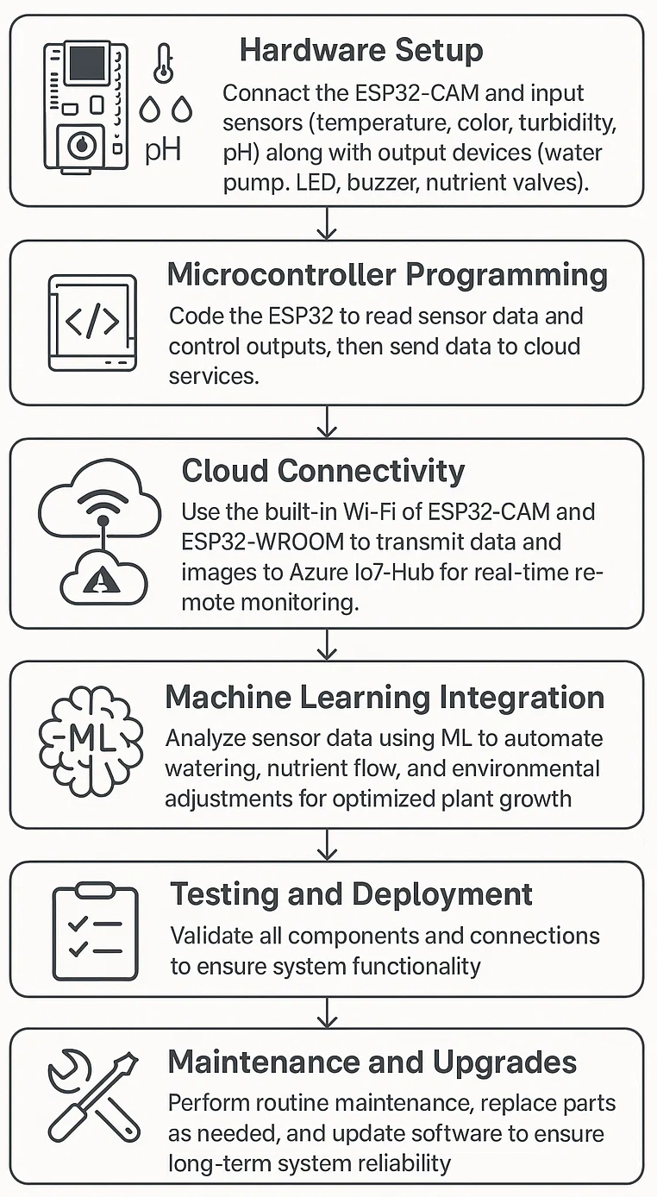
Methodology
B. HARDWARE METHODOLOGY
The hardware methodology outlines the steps for implementing the IoT- and ML-enabled hydroponic system:
Hardware Setup: Connect the ESP32-CAM and input sensors (temperature, color, turbidity, pH) along with output devices (water pump, LED, buzzer, nutrient valves).
Microcontroller Programming: Code the ESP32 to read sensor data and control outputs, then send data to cloud services.
Cloud Connectivity: Use the built-in Wi-Fi of ESP32-CAM and ESP32-WROOM to transmit data and images to Azure IoT-Hub for real-time remote monitoring.
Machine Learning Integration: Analyze sensor data using ML to automate watering, nutrient flow, and environmental adjustments for optimized plant growth.
Testing and Deployment: Validate all components and connections to ensure system functionality.
Maintenance and Upgrades: Perform routine maintenance, replace parts as needed, and update software to ensure long-term system reliability.

Slide 13
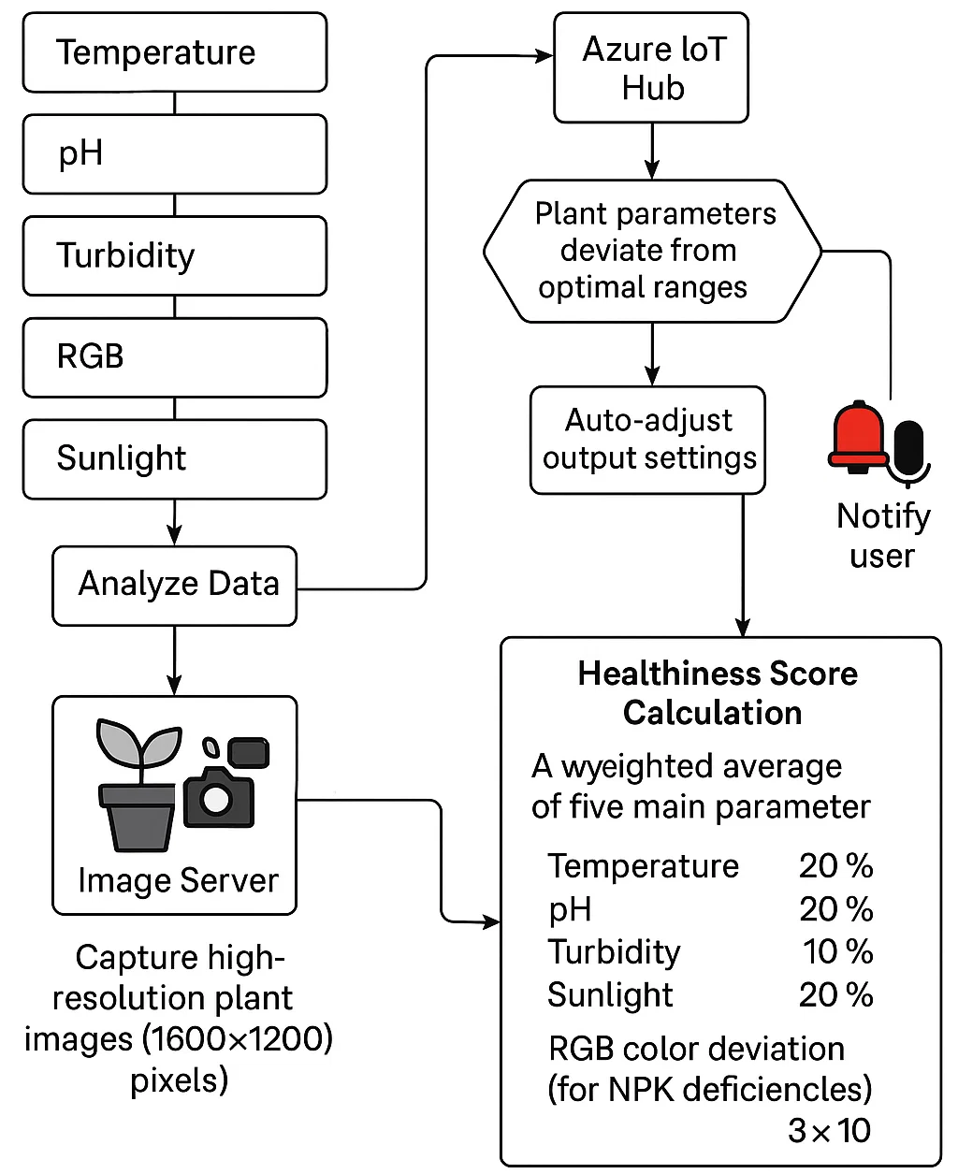
Methodology
C. SOFTWARE METHODOLOGY 1) COMPUTATION OF HEALTHINESS SCORE
System Workflow
The system continuously gathers data from sensors (Temperature, pH, Turbidity, RGB, Sunlight).
Data is analyzed locally and sent to the cloud (Azure IoT Hub).
If plant parameters deviate from optimal ranges:
The system auto-adjusts output settings.
User is notified via lights and buzzers.
A dedicated image server captures high-resolution plant images (1600x1200 pixels) for classification.
Azure DataBricks calculates a “Healthiness Score” every minute.
Healthiness Score Calculation
The score is a weighted average of five main parameters:
Temperature: 20%
pH: 20%
Turbidity: 10%
Sunlight: 20%
RGB color deviation (for NPK deficiencies): 3 × 10%
Input Sources for Each Parameter
Temp, pH, Turbidity: Real-time sensor readings.
Sunlight Intensity: Lux meter sensor.
RGB Deviation: Color sensor readings used to assess NPK deficiencies.
Visual Guidance: Refer to Figures 4 & 5 for:
Software flowcharts (sensor & image system).
Scoring ranges and color deviation weights.

Slide 14
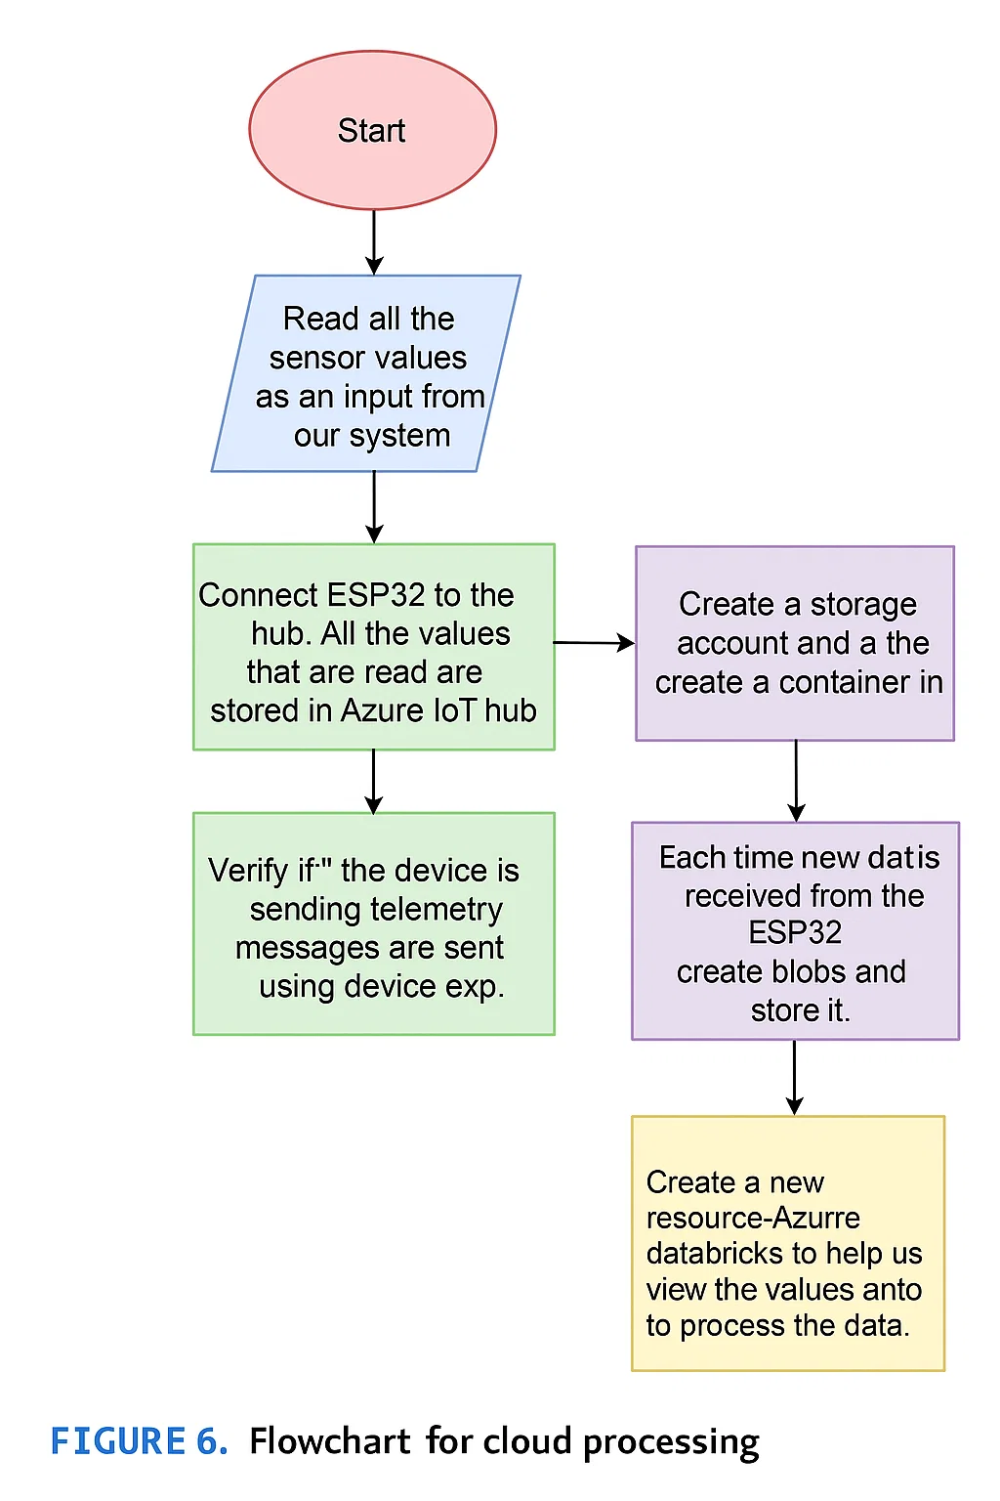
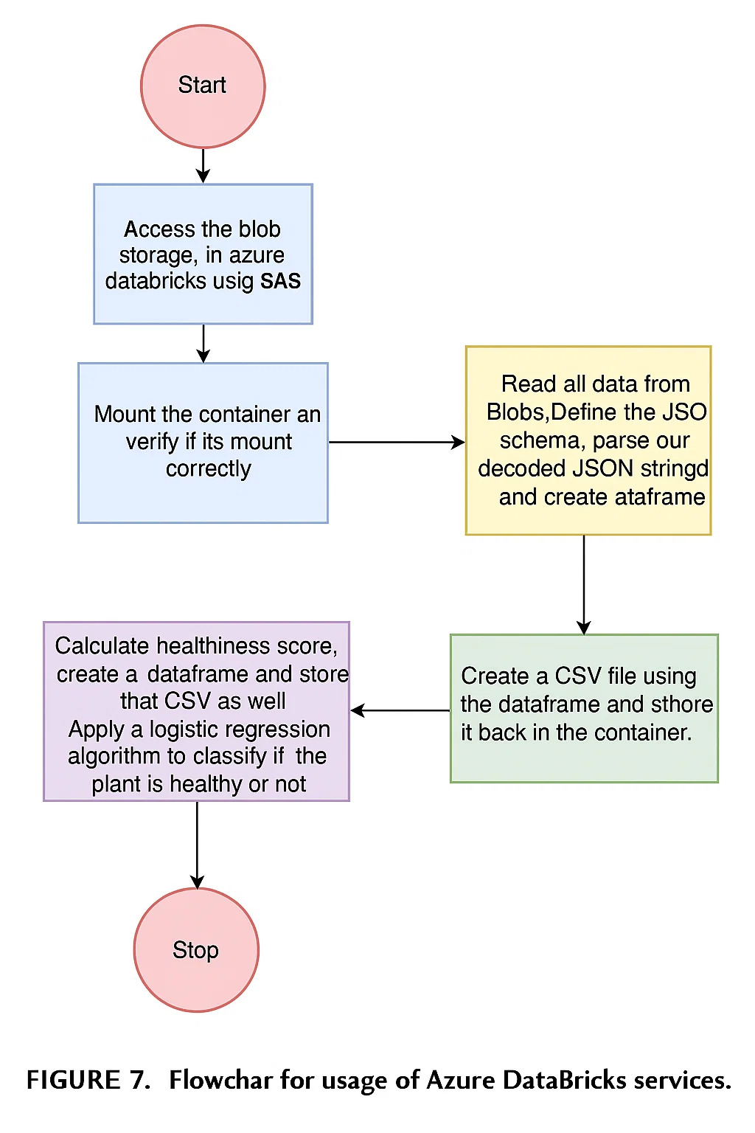
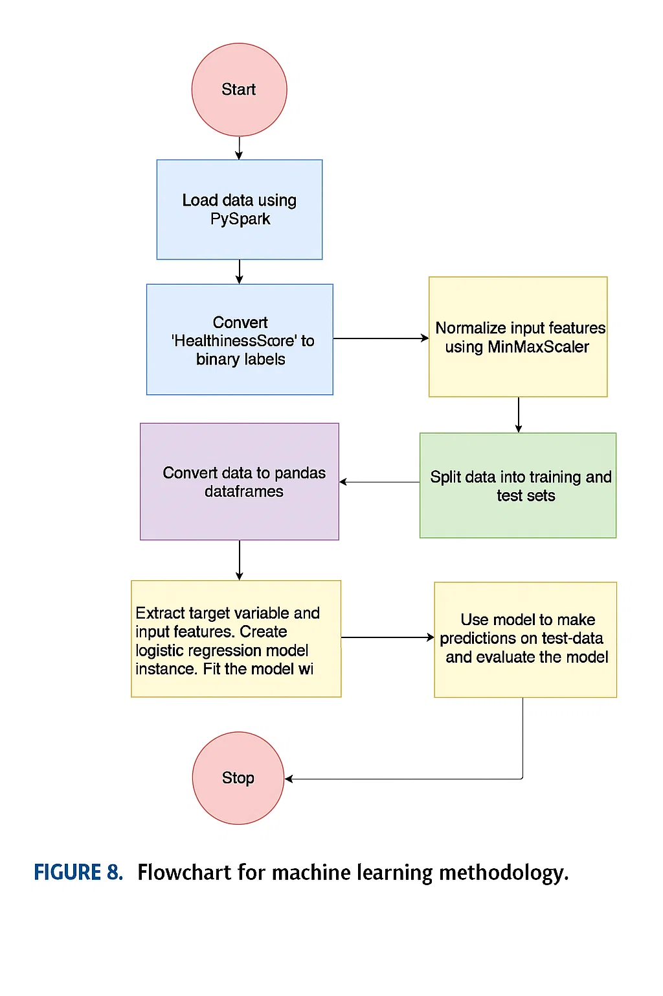
Methodology
C. SOFTWARE METHODOLOGY 2) CLOUD PROCESSING METHODOLOGY
The proposed hydroponic system uses an ESP32 microcontroller to collect sensor data (e.g., temperature, pH, RGB light levels, etc.) and send it to Azure IoT Hub in JSON format. This data is stored in Azure Blob Storage for organized and time-based access.
Figure 6 illustrates the cloud integration process: sensor data is sent from ESP32 to the cloud, where it’s saved as blobs. Telemetry is verified using Azure Device Explorer. Azure DataBricks is used to view and process this data.
Figure 7 shows the next phase using Azure DataBricks: the blobs are accessed, JSON data is parsed into data frames, and a healthiness score is computed. A logistic regression algorithm is applied to determine if the plant is healthy or not.
Figure 8 outlines the machine learning workflow: data is loaded using PySpark, normalized, split into training/test sets, and used to train a logistic regression model that predicts plant health.
The logistic regression algorithm iteratively adjusts parameters using gradient descent to minimize prediction error, including regularization to prevent overfitting.

Slide 15
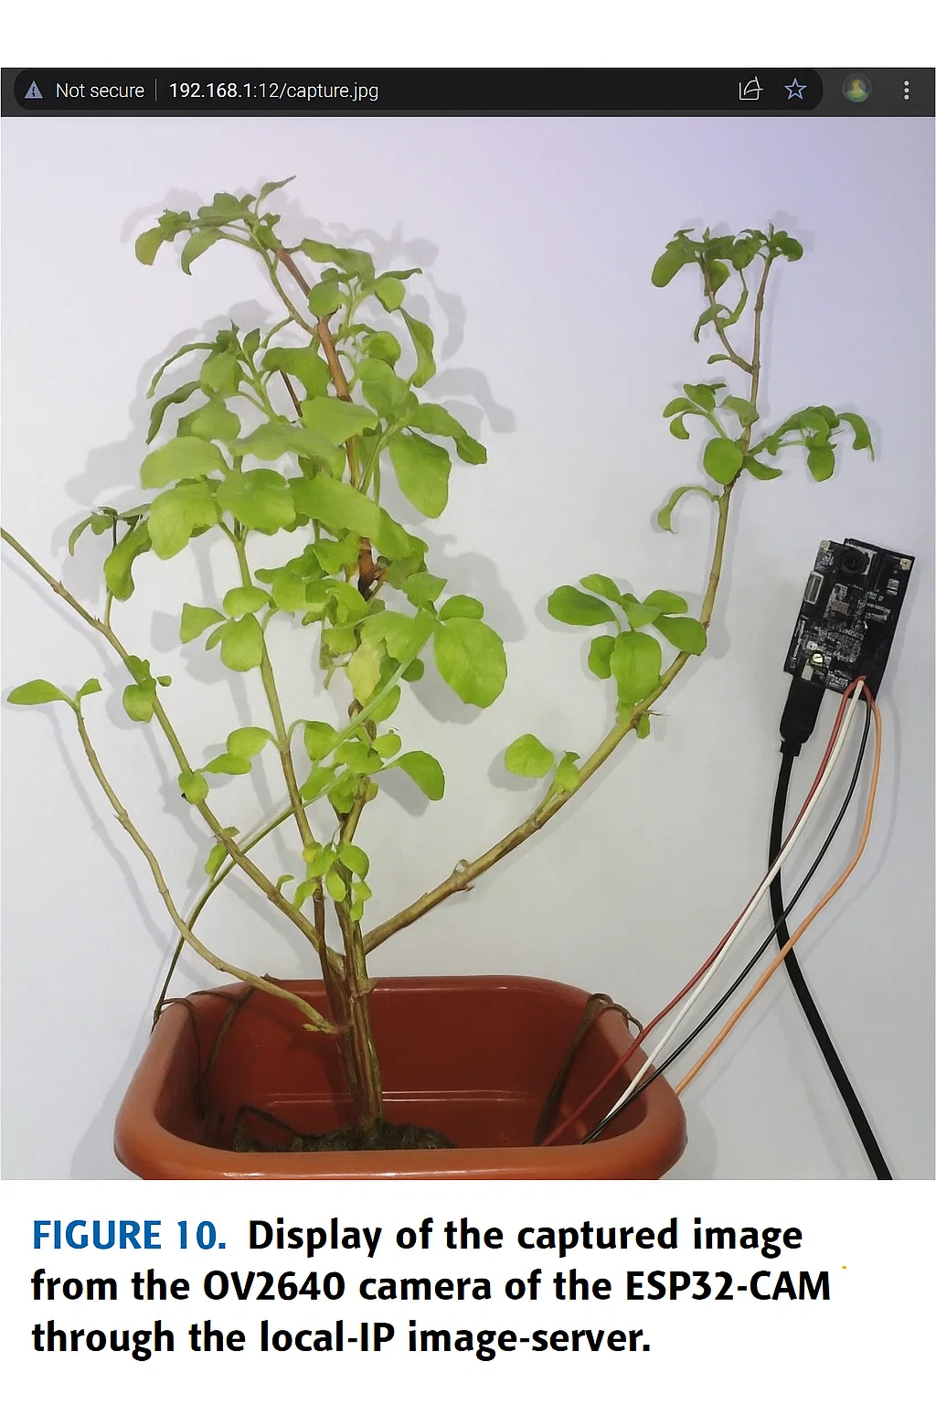
Results
A. HARDWARE SETUP OF IoT AND ML BASED HYDROPONICS SYSTEM
This study presents an AI-powered hydroponic system designed to cultivate medicinal and exotic plants, specifically Rama Tulsi (Holy Basil). The system uses logistic regression to analyze sensor data and regulate essential growth factors like nutrients, water flow, and light. It employs the ESP32S microcontroller and a 2MP OV2640 camera module to capture plant images, as shown in Figure 10.
Additionally, a decision tree algorithm detects deficiencies in nitrogen (N), phosphorus (P), and potassium (K) using sensor readings. The hardware components—shown earlier in Figure 9—include the ESP32-CAM for image capture, the ESP32-WROOM for data handling, RGB color sensors, temperature sensors, turbidity sensors, and a pH sensor. Submersible pumps manage water circulation in the DWC hydroponic setup.

Slide 16
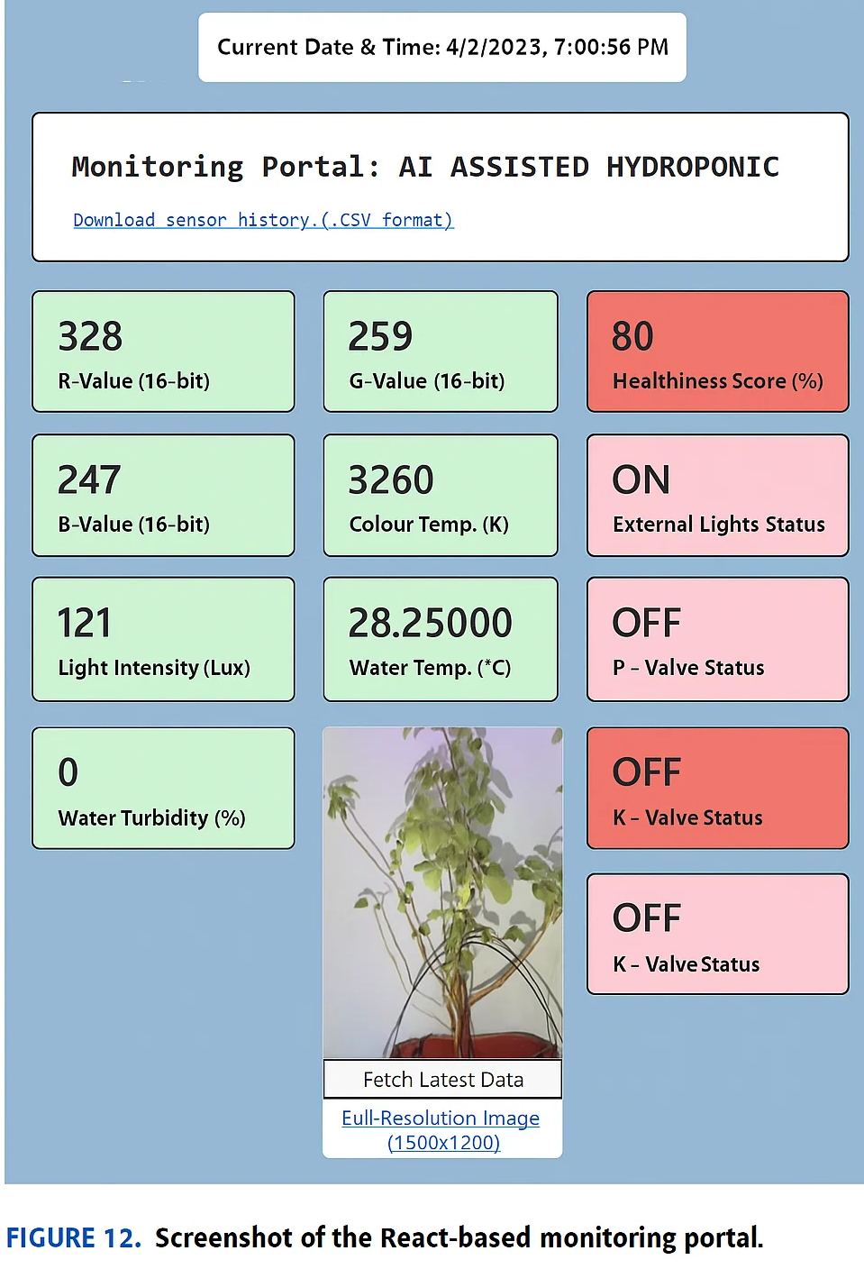
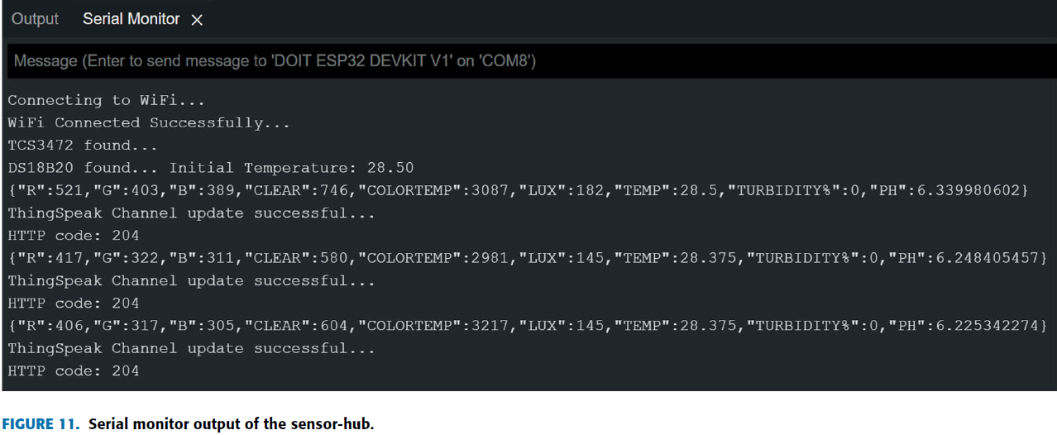
Results
B. SCREENSHOTS FROM IDE OF IMAGE SERVER AND SENSOR-HUB
The implemented AI-assisted hydroponic system effectively automates environmental monitoring and output control to improve the growth and health of exotic and medicinal plants. The system supports real-time observation and plant-specific adjustments, and its cloud-based analysis enables early detection of plant diseases.
Figure 10 shows the image captured by the OV2640 camera of the ESP32-CAM using the built-in LED light. This image can be accessed using the local IP, delivering a 1600×1200 resolution.
Figure 11 confirms that the ESP32-WROOM microcontroller was successfully flashed and connected via Wi-Fi. It shows successful sensor initialization and the transmission of sensor data in JSON format to the Azure IoT-Hub.
Figure 12 presents a screenshot of the React-based monitoring portal, which displays real-time sensor values, the Healthiness Score, and the statuses of water pump, light, and valves.
The system proves scalable and suitable for expansion and long-term use.

Slide 17
Results
C. SCREENSHOTS OF THE REACT-BASED MONITORING PORTAL
Figure 12 illustrates a React-based monitoring portal built using JavaScript, HTML, and CSS. The portal provides comprehensive information about the plant:
Left (green boxes): Displays real-time sensor data sent from the sensor-hub to the cloud.
Right (red boxes): Shows cloud-processed control parameters used to manage valves, lights, and the water pump.
Center: Displays the current plant image with buttons to refresh data, recapture the image, and view it in full resolution.
Top section: Shows the current date and time, along with links to download sensor and output data in CSV format.
D. SCREENSHOTS FROM AZURE IoT-HUB AND DATA BRICKS WITH HEALTHINESS SCORE PREDICTION
This section discusses the screenshots from Azure IoT Hub and DataBricks related to the prediction of the Healthiness Score:
Figure 13 shows the latest 5 rows of a processed CSV file containing 5794 entries. A new column named HealthinessScore has been added. The score increased from 80 to 85 after parameter optimization in the hydroponics system.
Figure 14 presents evaluation metrics—precision, recall, F1-score, and support—used to measure the model's performance.
Figure 15(a) shows the classification results from the model for input and test data.
Figure 15(b) displays the confusion matrix with:
TP (11): Correctly predicted as healthy.
FP (01): Predicted as healthy, but actually unhealthy.
FN (00): Predicted as unhealthy, but actually healthy.
TN (10): Correctly predicted as unhealthy.
Azure DataBricks allows users to schedule data processing intervals and receive alerts, ensuring timely updates and monitoring.

Slide 18
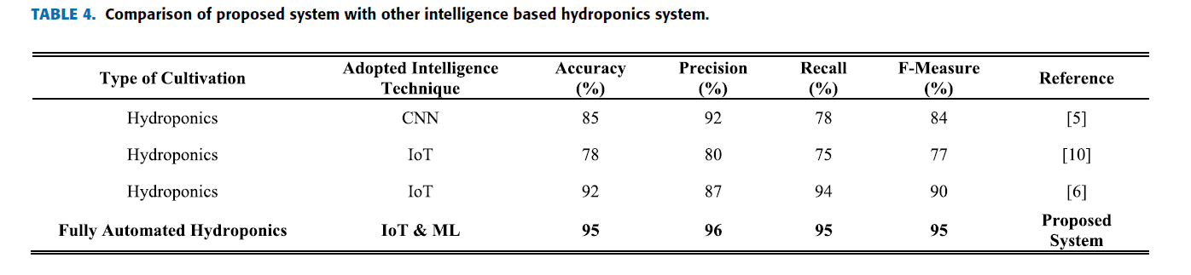
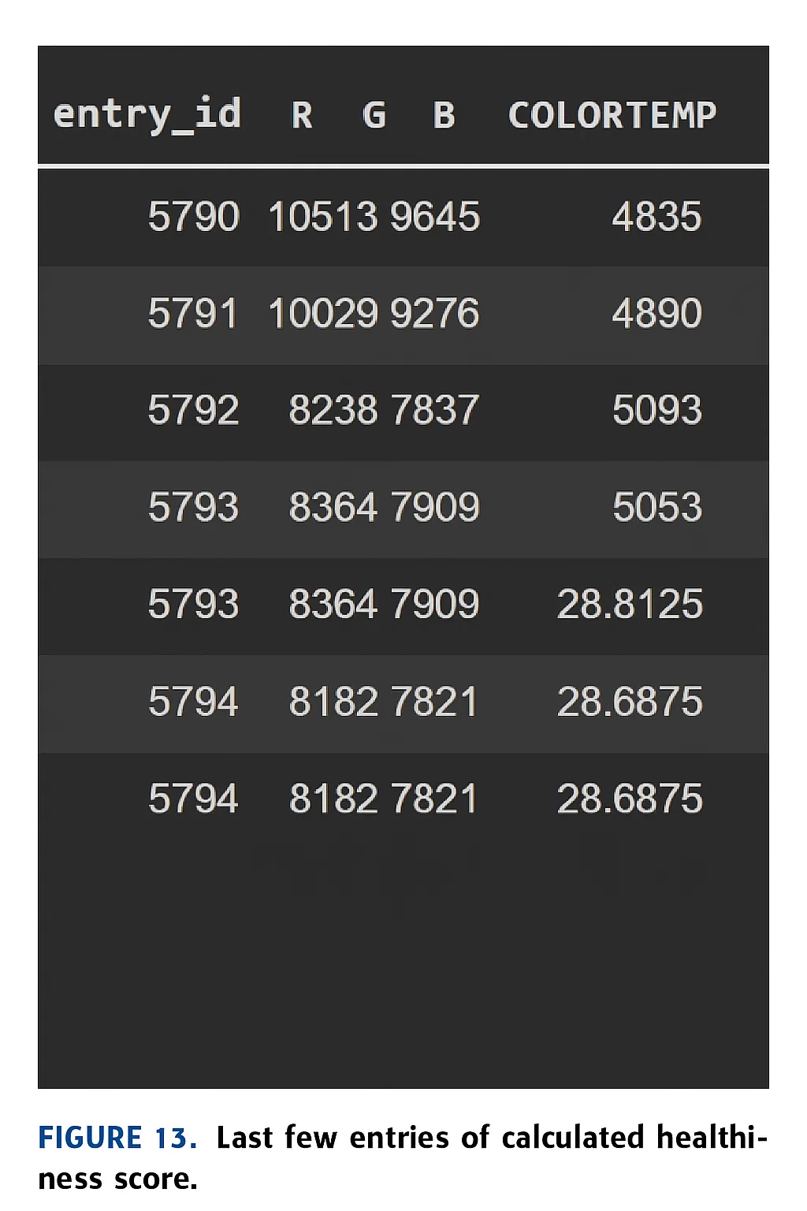
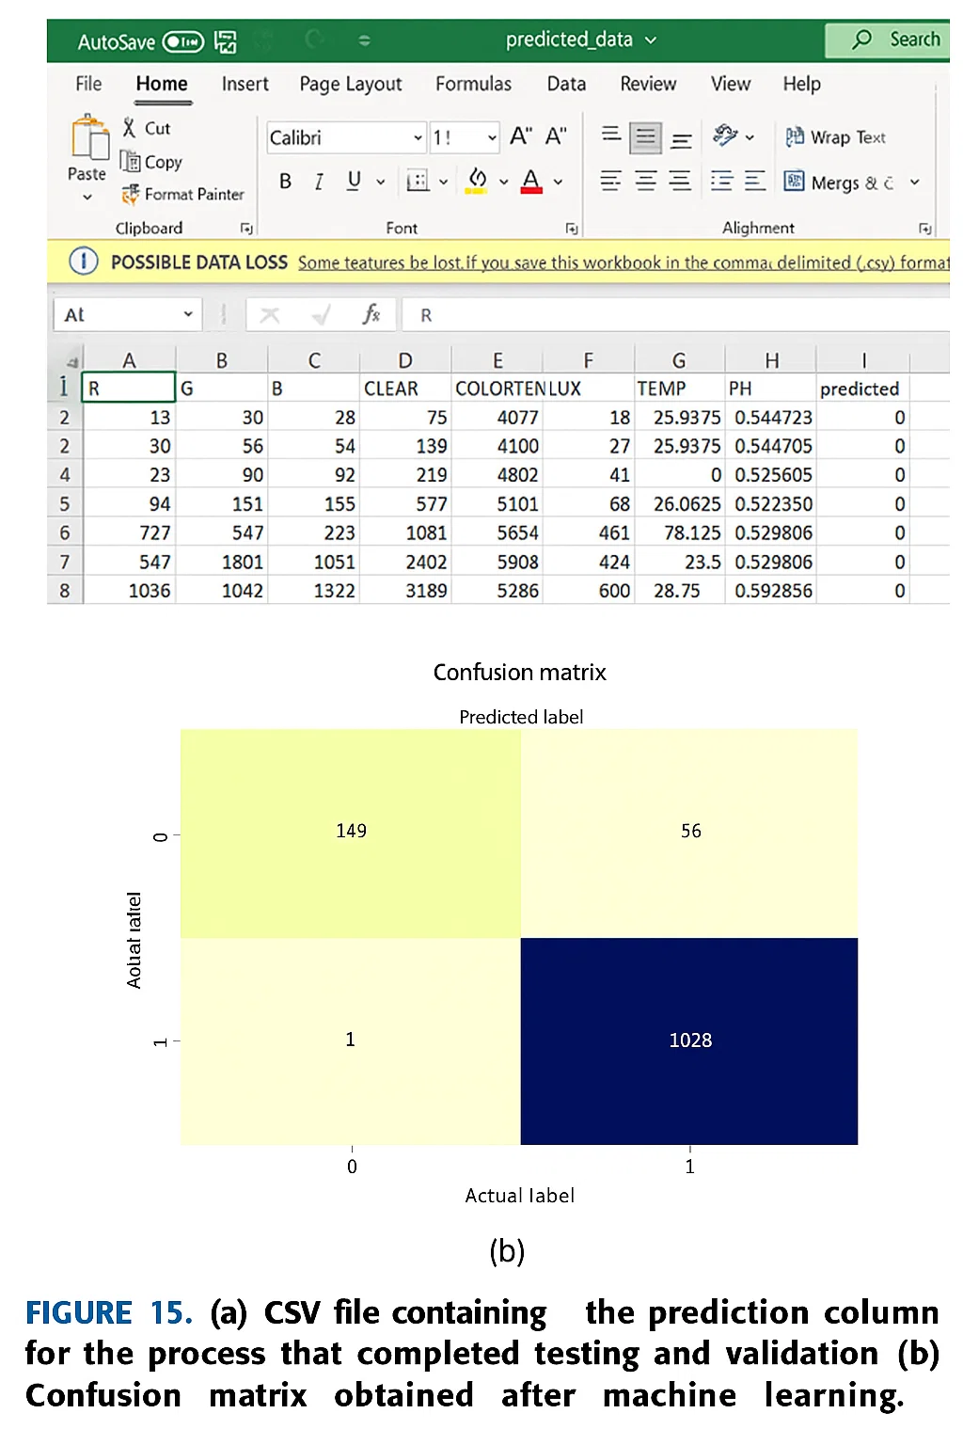
Results

Slide 19
Results
E. COMPARISON AND COST ANALYSIS
Few studies have explored real-time, fully automated hydroponic systems. The proposed system stands out with a 95% validation accuracy and F-measure. Its total cost is approximately \$60 (4700 INR), with the pH sensor being the most expensive component (~~\$20) and the DS18B20 temperature sensor the least (~~\$1.35). Other components include ESP32 modules, sensors, nutrients, and pumps. Future costs will involve periodic maintenance, nutrient refills, and plant replacement. System expansion could raise costs by 30%. Despite this, the system is cost-effective due to higher yields, improved plant health, and lower water use.

Slide 20
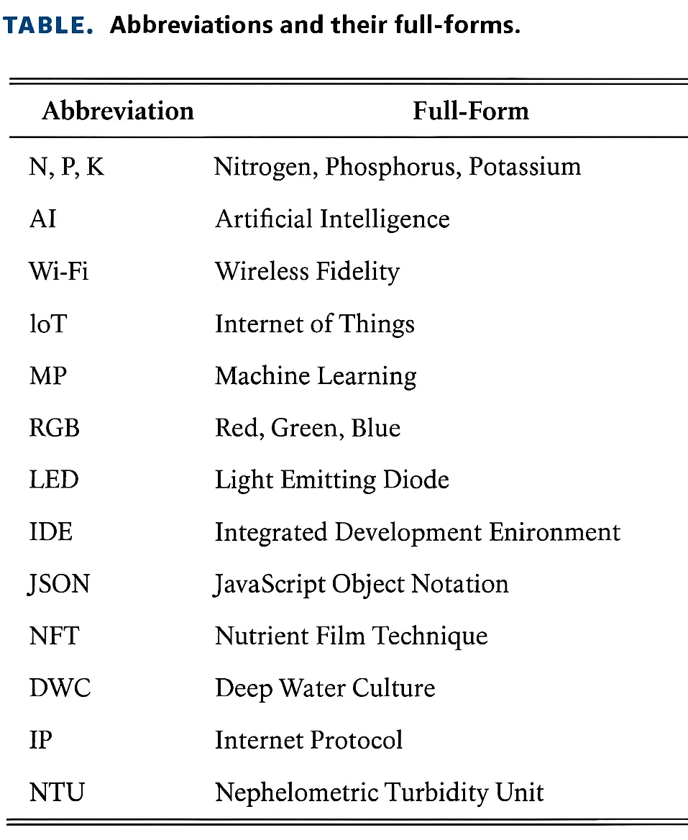
CONCLUSION
The proposed Hydroponics System is an IoT- and AI-based solution optimized for growing Holy Basil. It uses ML algorithms like logistic regression and decision trees to automatically adjust environmental parameters, reducing the need for manual monitoring. The system includes various sensors (temperature, humidity, RGB, pH), nutrient control valves (for N, P, K), and a web-based monitoring portal. Cloud computing plays a vital role by storing, analyzing, and enabling intelligent decision-making based on sensor data.
While effective, the system has limitations such as reliance on historical data, hardware constraints, and potential need for human intervention in complex scenarios. It may also require adjustments to support different plant types. Regular maintenance is necessary.
Despite these challenges, the system demonstrates strong potential for enhancing hydroponic agriculture, especially in environments where traditional farming is impractical. It increases yield, reduces labor costs, and achieves up to 95% accuracy—outperforming previous solutions.

Slide 21
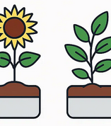
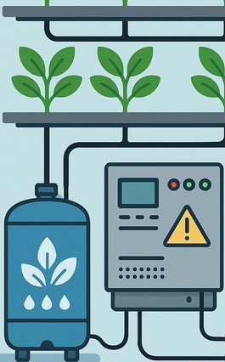
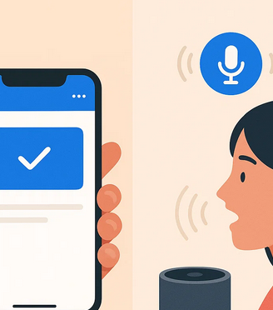
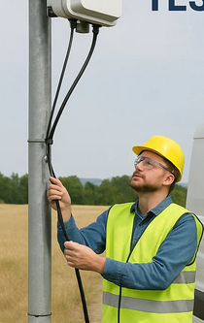
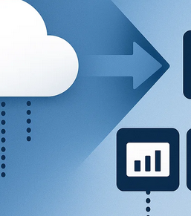
FUTURE SCOPE
Scalability to Multiple Plant Species
Automated Nutrient Refill and Maintenance Systems
Mobile and Voice-Controlled Interfaces
Commercial Deployment and Field Testing
Cloud-to-Edge Transition

Slide 22
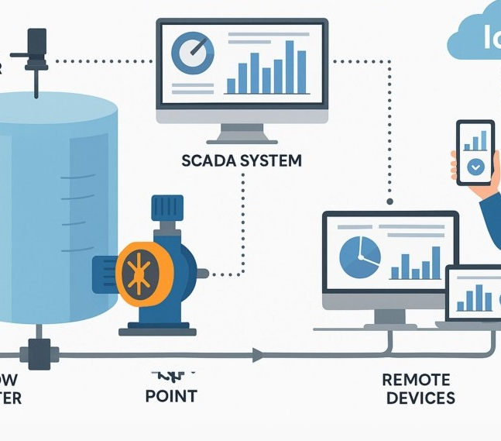


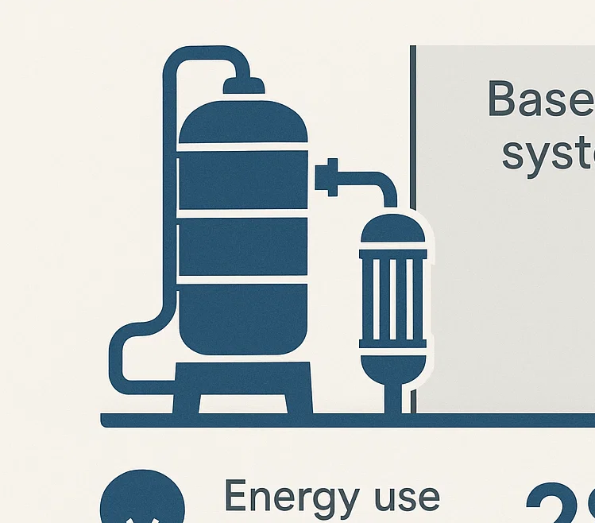
Thank you
Mahmoud Abu Aisha
mk.abuaisheh@std.alaqsa.edu.ps

